Slide 1



From Legal Autonomy to
Effective Regulatory Capacity
ARME's Experience in Cape Verde
Regulators' Financial Revenues to Ensure Their Independence of all Market Stakeholders
Carlos Ramos
Board Member
ARME – Multisectoral Economic Regulatory Agency, Cape Verde
Session 4c | 23 September 2026

Slide 2
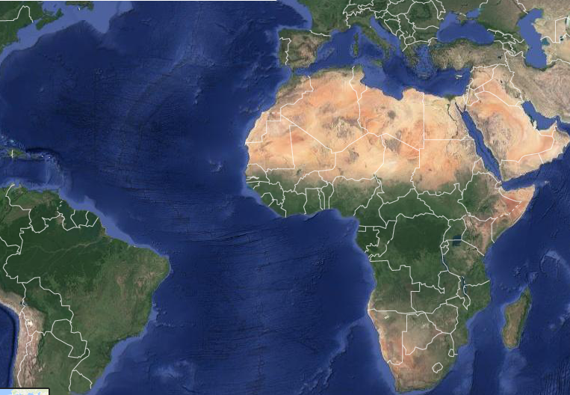

01
WHY FINANCIAL INDEPENDENCE MATTERS
A Small Island State Makes Regulatory Capacity Critical
Small island economy with 10 inhabited islands
Fragmented infrastructure and relatively small regulated markets
High exposure to imported energy and external shocks
Accelerating energy transition and electricity-sector reform
Growing regulatory complexity and investment needs
CAPE
VERDE
In small markets, limited regulatory capacity can quickly become a systemic constraint.

Slide 3
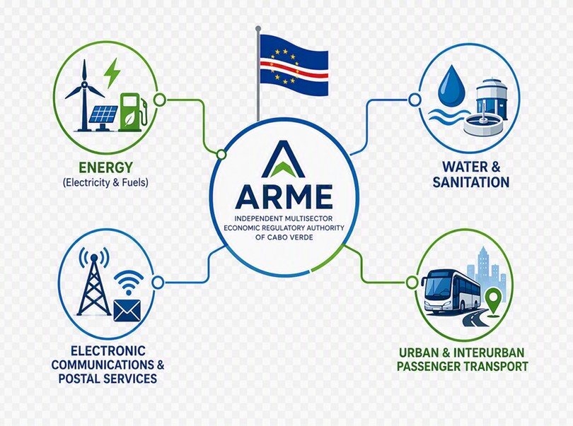
02
ARME: A MULTISECTOR REGULATORY MODEL
A One Regulator — Several Essential Sectors
ARME:
Independent administrative authority
Administrative, financial and patrimonial autonomy
Regulatory, supervisory, tariff-setting and enforcement powers
Multisector model designed to create economies of scale and technical synergies
For a small economy, multisector regulation can transform scale constraints into institutional synergies.

Slide 4
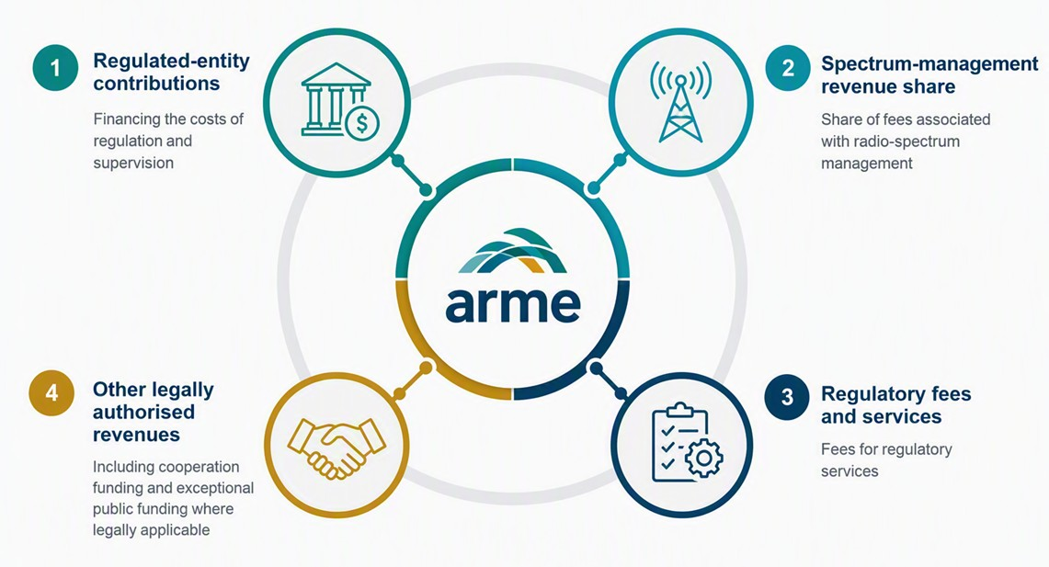
03
HOW ARME IS FINANCED
A Diversified Legal Revenue Framework
04
Diversification reduces dependence — but the real test is predictability and collectability.

Slide 5
04
THE REAL FINANCIAL INDEPENDENCE TEST
From Legal Revenue to Regulatory Capacity
LEGAL
ENTITLEMENT
ASSESSED
REVENUE
BILLED
REVENUE
COLLECTED
CASH
REGULATORY
CAPACITY
THREE TESTS
Adequate?
Predictable?
Collectable?
Revenue on paper is not regulatory capacity in practice.

Slide 6
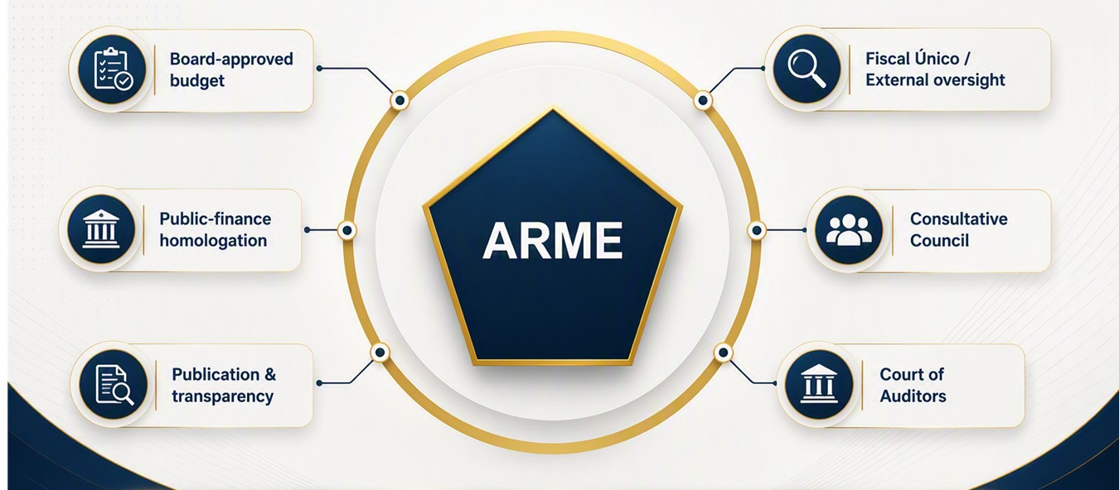
05
INDEPENDENCE WITH ACCOUNTABILITY
Financial Autonomy Does Not Mean Absence of Oversight
Independence and accountability are complements — not substitutes.

Slide 7
06
THE MULTISECTOR MODEL: STRENGTH AND CHALLENGE
Diversification Creates Resilience — If Properly Managed
STRENGTHS
CHALLENGES
Shared technical expertise
Common support systems
Economies of scale
Broader revenue base
Revenue concentration
Collection delays
Sector cost allocation
New mandates without matching resources
BALANCE
Several legal revenue sources do not automatically mean financial resilience.

Slide 8
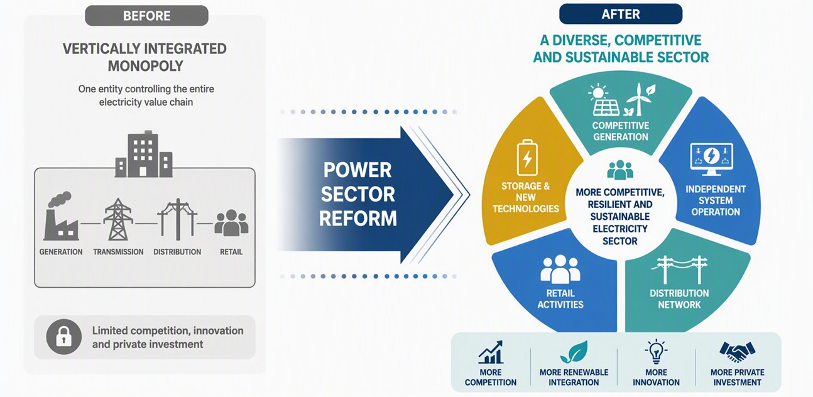
07
ENERGY TRANSITION RAISES THE STAKES
More Complex Markets Require Stronger Regulatory Capacity
New regulatory mandates must be matched by adequate resources.

Slide 9
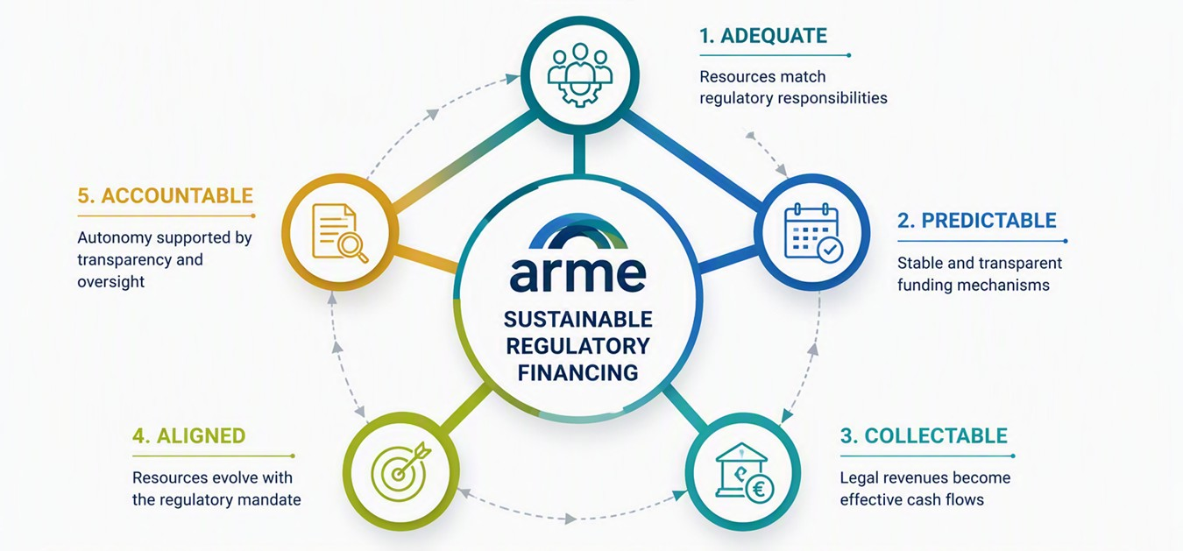
08
CONCLUSION
What Makes Financial Independence Effective?
Good regulatory funding is not about protecting the regulator — it is about protecting the regulatory process.

Slide 10
Thank you
carlos.ramos@arme.cv
www.arme.cv

